Slide 1
Quadrilaterals

Slide 2
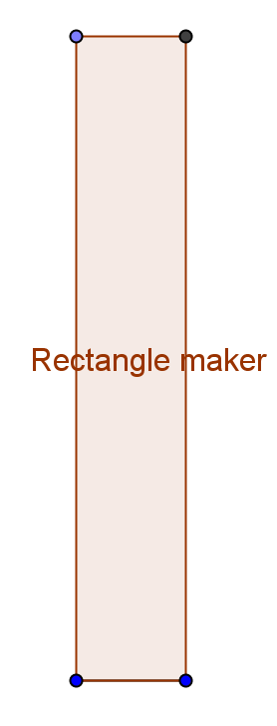
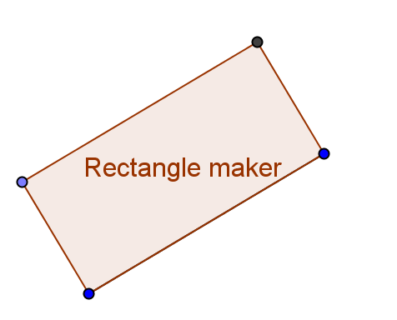
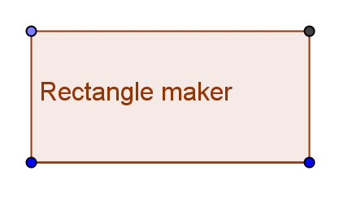
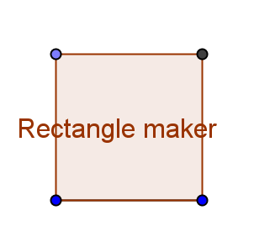
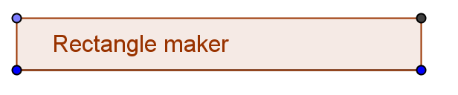
Rectangles

Slide 3
Rectangles
Grade PreK and not-in-school definition:
Right angles and 2 long and 2 shorter sides
Grade 3 and up school definition:
Quadrilateral with right angles (a square is a special kind of rectangle)

Slide 4


Why is it important to include squares?
Multiplication problems give rectangles and squares both
And the area of a rectangle formula works for squares too.

Slide 5
Rectangle properties
2 pairs of parallel sides
Angles are 90°
symmetrical horizontally and vertically
2 pairs of opposite equal sides

Slide 6
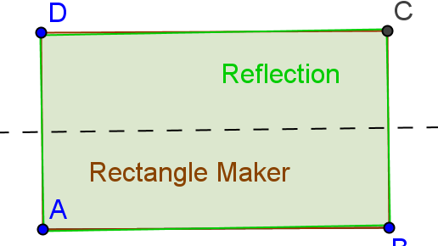
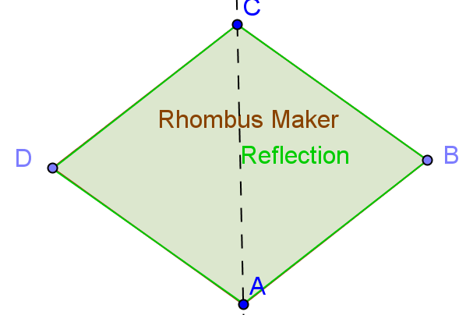
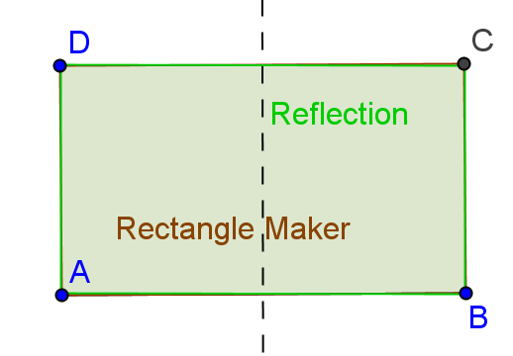
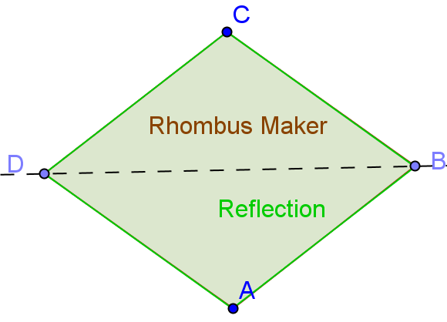
Horizontal and vertical symmetry?

Slide 7
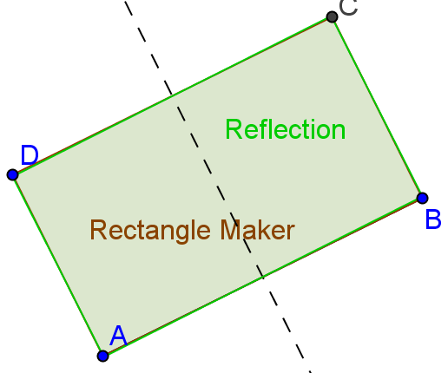
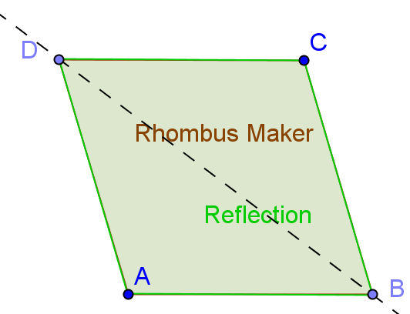
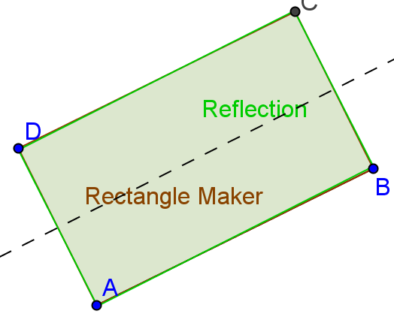
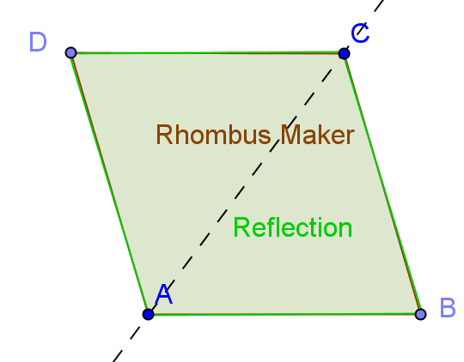
Horizontal and vertical symmetry?

Slide 8
What about rectangle reflection lines?

Slide 9
Rectangle properties
2 pairs of parallel sides
angles are 90°
symmetrical across symmetry lines that go between midpoints of opposite sides
2 pairs of opposite equal sides

Slide 10
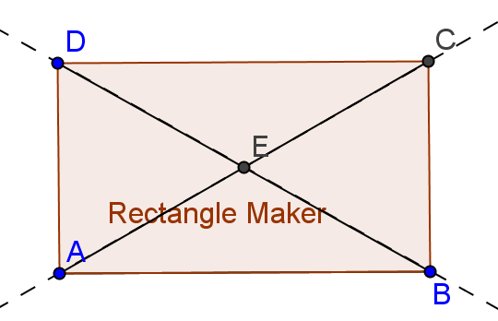
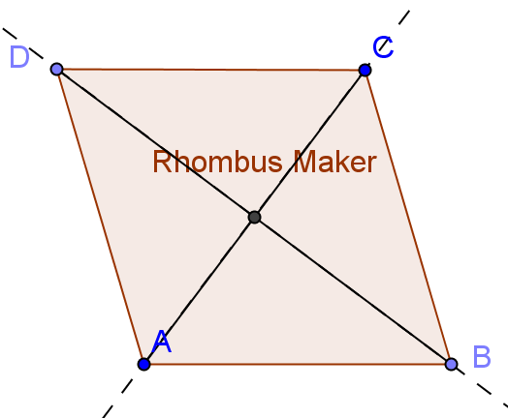
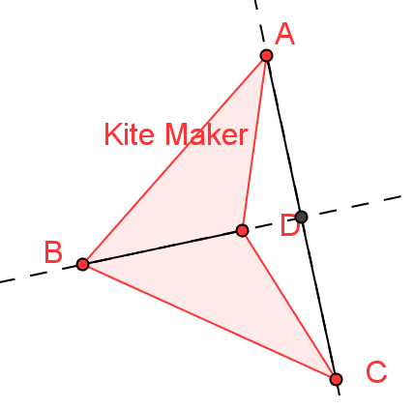
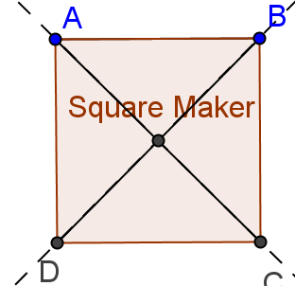
Diagonals

Slide 11
Rhombus properties
Have 2 pairs of parallel sides
All sides are equal in length
Have horizontal and vertical diagonal line symmetry (both diagonals
2 pair of equal angles (adjacent? across from each other?)

Slide 12
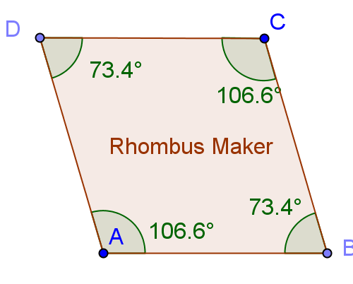
2 pair of equal angles (adjacent? across from each other?)

Slide 13
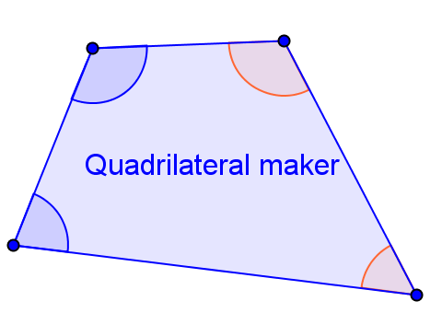
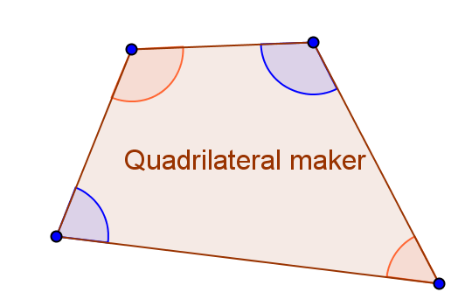
Opposite and Adjacent angles

Slide 14
Rhombus properties
Have 2 pairs of parallel sides
All sides are equal in length
Have diagonal line symmetry (both diagonals)
2 pairs of equal opposite angles (across from each other)

Slide 15
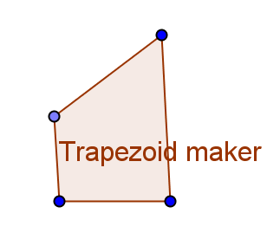
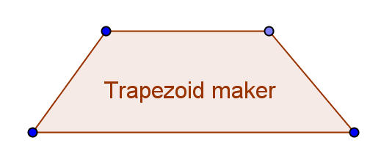
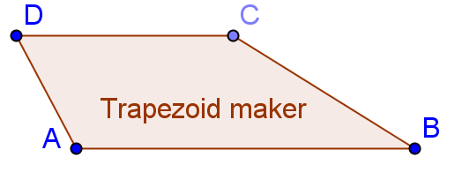
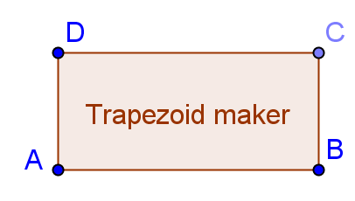
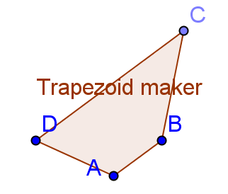
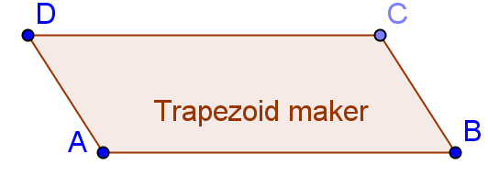
Always two acute and two obtuse angles?

Slide 16
Which properties does this trapezoid maker have?
One pair of parallel sides
Only one pair of parallel sides
The angles on either side of the base are the same
two acute and two obtuse angles
Has a line of symmetry (?)
Vertical symmetry line if the non-parallel sides are equal

Slide 17
This trapezoid maker follows the properties and definitions:
One pair of parallel sides
Only one pair of parallel sides (other definitions have this condition)
Has a line of symmetry perpendicular to the parallel sides if the non-parallel sides are equal

Slide 18
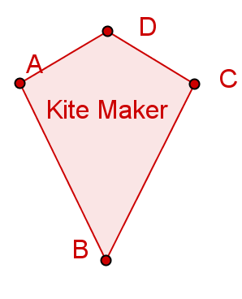
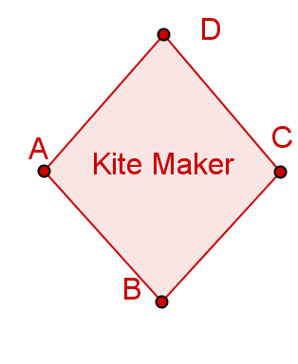
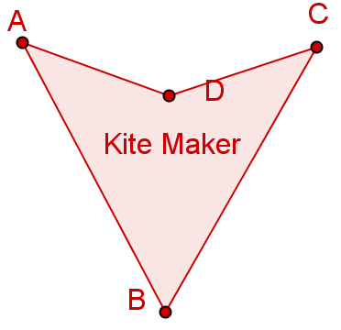
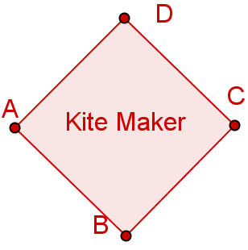
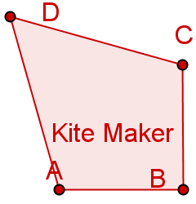
A Kite maker can make these shapes:

Slide 19
Kite properties
Two pair of equal adjacent sides
Has symmetry (2 lines?)

Slide 20
Kite properties
Two pair of equal adjacent sides
Has symmetry around one of its diagonals—the one that goes between the congruent sides.

Slide 21
Make a page of parallelograms and properties
Make a set of parallelograms (lots of parallelograms on the same page, so it shows the variety of shapes the parallelogram maker can make.
Make a good and correct set of properties for parallelograms

