Slide 1
Each of these shapes always has two pairs of angles that are supplementary (add up to 180°). Some of these shapes do not have all right angles. Some of these shapes do not have any congruent sides. What shapes am I thinking of?
Take away shapes that don’t fit
Shapes that have all right angles don’t fit:
Not a square, not a rectangle,
Shapes that always have congruent sides don’t fit:
Not a: rhombus, parallelogram, kite,
Not a general quadrilateral because we found a quadrilateral without a pair of supplementary angles
The trapezoids we checked did always have supplementary angles.

Slide 2
Translations

Slide 3
Where should it translate to?

Slide 4
Where should it translate to?

Slide 5
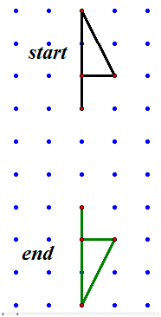
Reflections

Slide 6
More reflections

Slide 7
Where should this reflect to?

Slide 8
Reflect then translate

Slide 9
Rotations

Slide 10
Rotations

Slide 11
Rotations

Slide 12
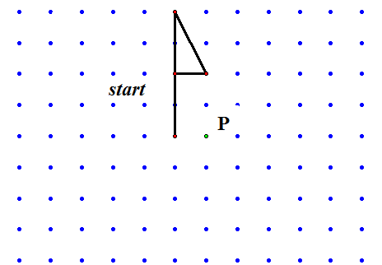
Rotations
Rotate 90° counter clockwise around P

Slide 13
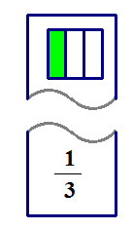
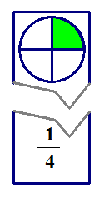
A lesson idea:
Have students work in small groups preparing sets of fraction cards. Have students write a fraction on the bottom of each card. Then draw a corresponding geometric representation on the top.
Display the top part and have another group match the bottom part. Then display the bottom portion and have a different group match the top part.
Name a fraction and have each group that used it show the picture they drew. Students need to know that there are many geometric representations that can be used for the same fraction.

Slide 14
Where’s the question?
Big Ideas: Fractions can be represented in several ways
Fractions show parts of a whole
Jessica’s idea: How many ways can you show ¼?
At what level is this an appropriate and important question to answer this?
Could children understand the question?
Do they have a way to try to answer the question?
Are there things they could learn from this question?

Slide 15
what about understanding the numerator* and the denomenator* and why it needs to be set up that way
Give examples and maybe non-examples
Think out examples well to make this into an inquiry lesson.

Slide 16
Inquiry
Start the lesson with a question
Build the activities around children trying to find an answer to the question.

